Slide 1
Polyolefin Catalysts

Slide 2
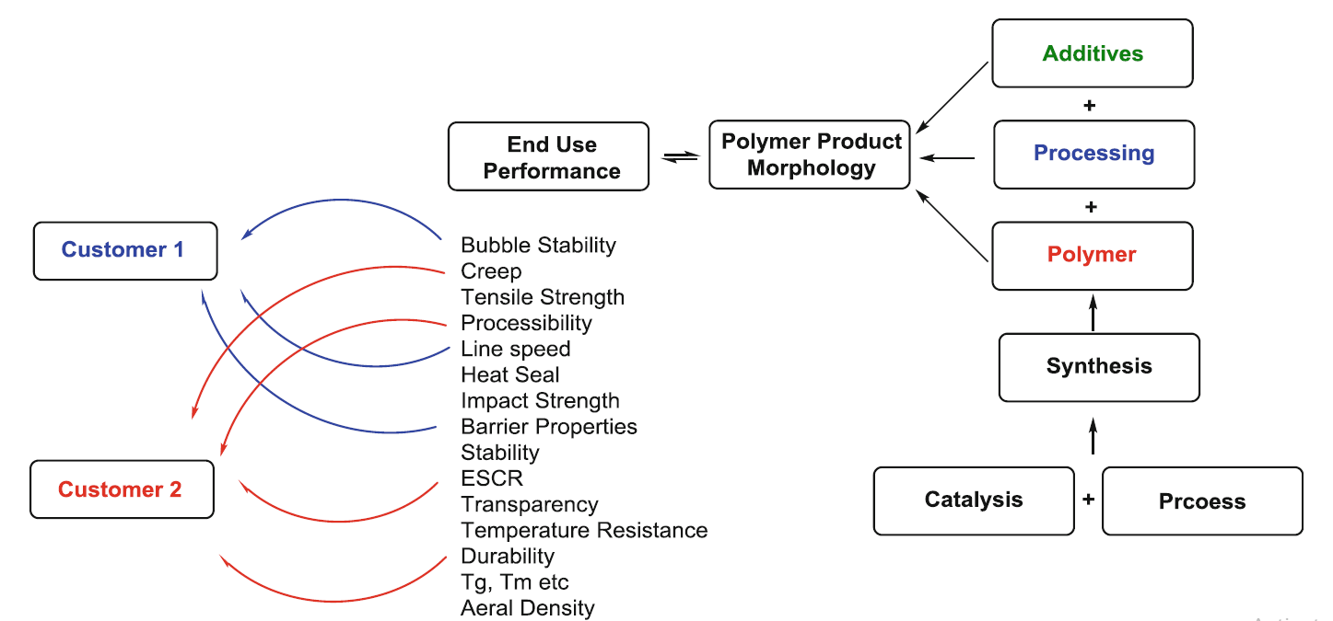
chain of Polyolefin knowledge

Slide 3
Ziegler Catalysts
Ziegler/Natta Polypropylene Catalysis
TiCl3 Catalysts (First Generation)
The reduction of TiCl4 with an aluminum alkyl, generating a solid TiCl3 precipitate.
TiCl3 exists in four crystalline modifications, α, β, δ, and γ forms. The β-modification has a linear chain-like structure, while α, δ, and γ forms possess layer structures.
Typically, the reaction of TiCl4 and AlEt3 (at low Al/Ti ratios) at low temperatures in hydrocarbon solution resulted in the controlled precipitation of catalysts having spheroidal particle morphology, yielding the β-TiCl3 form with cocrystallized AlCl3.

Slide 9
This precursor can be converted to the more stereoselective γ-form by heating to 160–200 C [21]. The catalysts were typically activated by AlEt2Cl to afford poorly productive systems (ca. 1 kg PP/g Cat) which
in many cases yielded polypropylene resins that required extractive removal of atactic polymer and removal of catalyst residues (deashing).
TiCl3 Catalysts (Second Generation)
The catalytic activity could be greatly improved by extraction of the co-crystallized aluminum chloride with diisoamyl ether, giving a “pure” β-TiCl3. Subsequent treatment with TiCl4 catalyzed the phase transformation from the β- to the δ-form of TiCl3 at a relatively mild temperature (<100 C) [23]
The innovation increased the activity and stereoselectivity and resulted in
polymerization productivities in the range 5–20 kg/g catalyst in bulk propylene and
produced polymers where the removal of the atactic fraction is spared [24]. Although
phased out in many locations these catalysts still survive to this day

Slide 13
Third Generation: “Activated” MgCl2
TiCl4 supported on MgCl2
Incorporation into the catalyst system of electron donors giving higher catalyst
stereospecificity
Initially, activated MgCl2 was prepared by ball milling a mixture of magnesium chloride and ethyl benzoate, which leads to the formation of very small (3 nm thick) primary crystallites of MgCl2

Slide 14
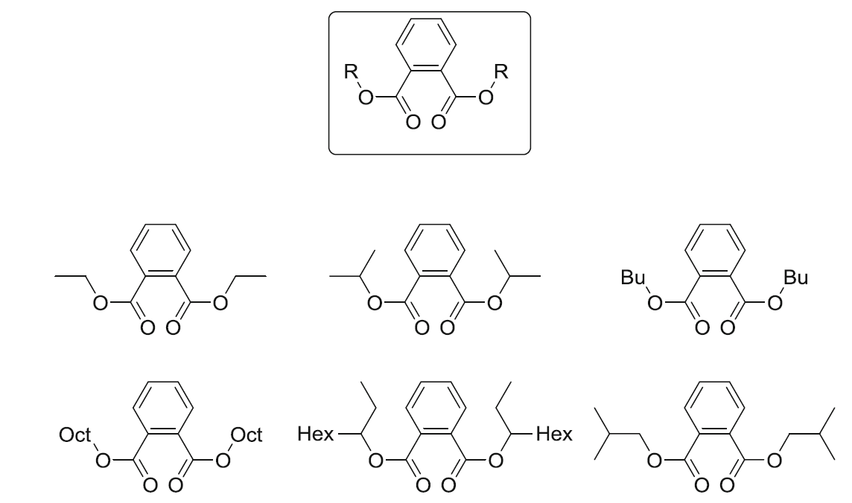
Fourth Generation: Phthalate ID/Alkoxysilane ED
Spherical MgCl2-based catalysts with controlled particle size and porosity, afforded via chemical rather than mechanical activation of magnesium chloride.

Slide 15
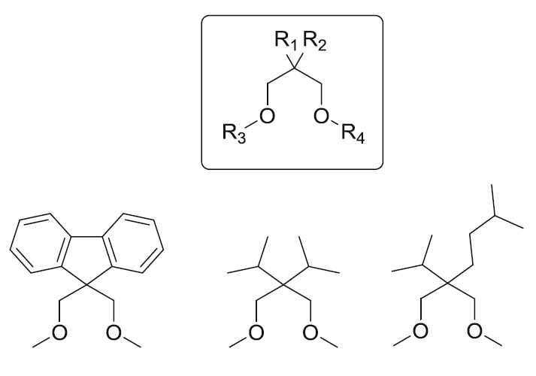
Fifth-Generation Catalysts: Diethers, Succinates, and Polyol Esters
It was found that certain diether compounds, in particular 2,2-disubstituted-1,3-dimethoxypropanes with an oxygen–oxygen distance in the range 2.8–3.2 Å (Fig. 1.3), similar to those of the alkoxysilane external donors are not extracted when the catalyst is brought into contact with the AlEt3 cocatalyst
Fifth-generation diether catalyst systems show particularly high polymerization activity and good stability, typically giving yields exceeding 100 kg PP/g catalyst. They also give relatively narrow molecular weight distribution and show high sensitivity to hydrogen.

Slide 16
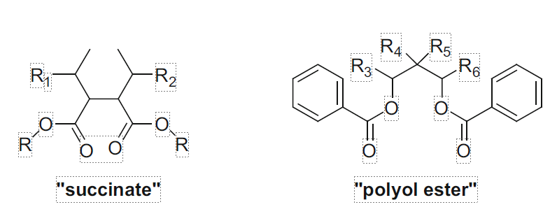
The essential difference between these catalysts is that the succinate-based systems produce polypropylene having much broader molecular weight distribution.
In addition, they also generate ethylene–propylene copolymers having considerably
lower glass transition temperature, coupled with better intermolecular and intramolecular comonomer distribution with respect to their conventional counterparts
production of heterophasic copolymers having an improved balance of stiffness and impact strength, taking into account that the incorporation of a rubbery (ethylene–propylene) copolymer phase into a PP homopolymer matrix increases impact strength but leads at the same time to decreased stiffness

Slide 17
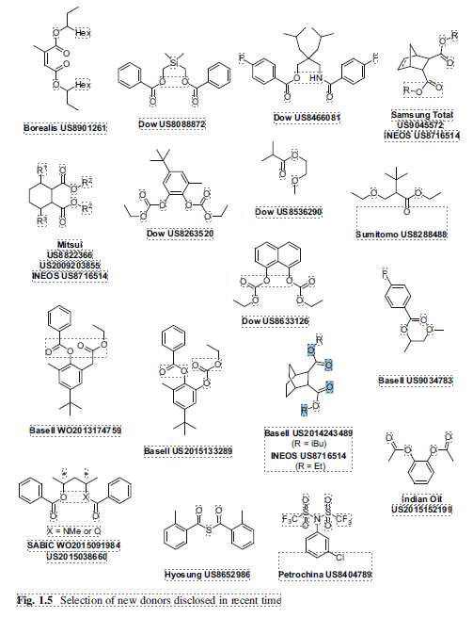
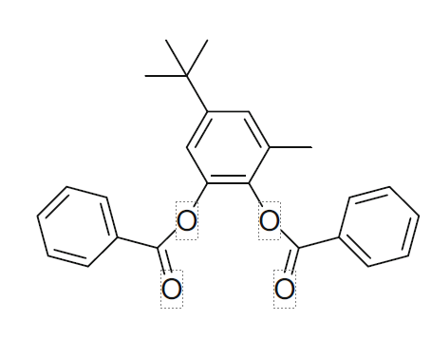
Sixth-Generation Ziegler: Phthalate Replacement
DOW Consista Donors
1,2-phenylene dibenzoate

Slide 18
Catalyst Morphology Control
1. Complexation of MgCl2 with an alcohol, forming a viscous melt at elevated
temperature, which is then processed to form a spherical MgCl2EtOHn support
with controllable EtOH content either via spray drying or emulsification/solidification.
The support material is treated with the external donor and titanated to
form the final catalyst product.
2. Complexation of MgCl2 with an alcohol in a hydrocarbon, followed by controlled
precipitation of the reaction products following addition of a chlorinating agent or
TiCl4.
3. Controlled precipitation of the reaction products of a magnesium alkyl or
alkoxide-containing complex with a chlorinating agent or TiCl4.
Finally
4. the impregnation of a silica carrier with the catalyst reagents

Slide 19
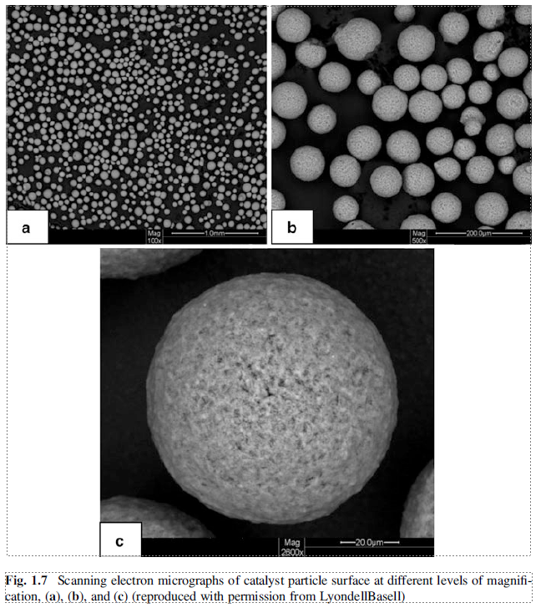
This base material has provided the backbone for
LyondellBasell developments
of Ziegler PP catalyst as well as
Zeigler PE catalyst for gas phase polymerization
Similar carrier material is employed in the
Sinopec/BRICI DQ-catalyst
Novolen
Süd-Chemie

Slide 20
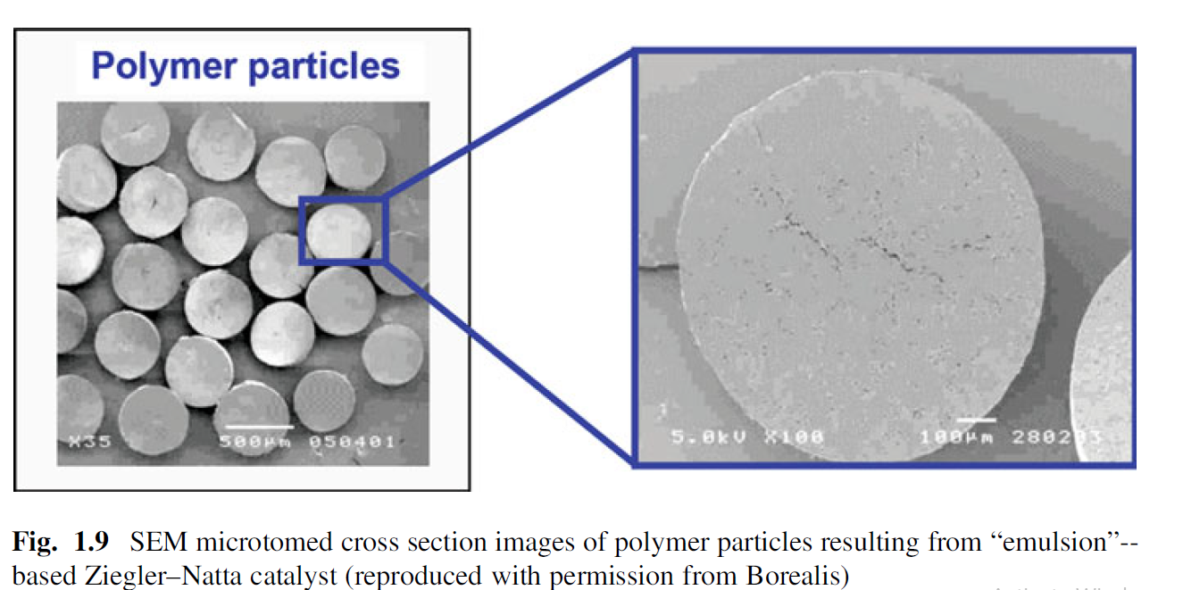
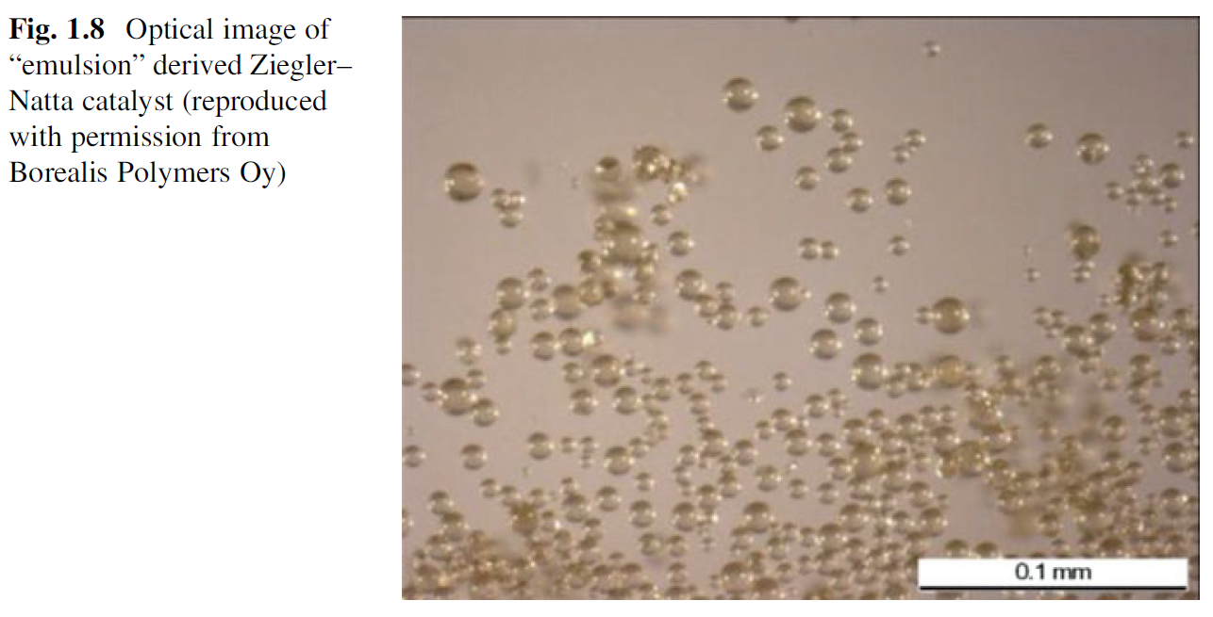

Slide 21
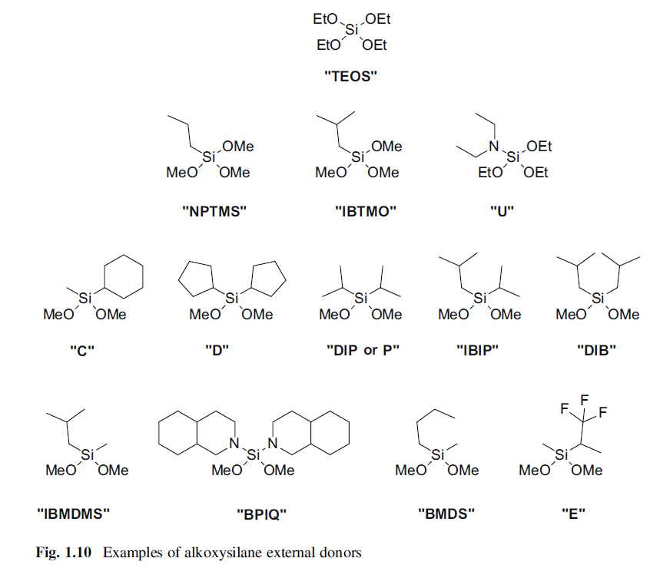
External Donors

Slide 22
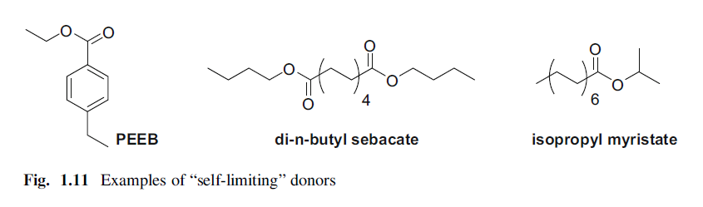

Slide 23
Ziegler Catalysts: Polyethylene
MgCl2–Titanium Catalysts on Silica
large pore volume and surface area
The silica is either physically impregnated with a solution of MgCl2/TiCl4 in THF
or chemically impregnated with the catalyst components, which can either be added
together or in differing orders. Common practice is to pacify the surface with an
alkyl-aluminum, magnesium complex or an organosilane.
Mobil [189] and UCC [190, 191], respectively. These catalysts, when combined with AlMe3 as a cocatalyst, were the first to produce so called “super-hexene” grade LLDPE, with
improved dart impart strength and hexane extractables
NOVACAT range

Slide 24
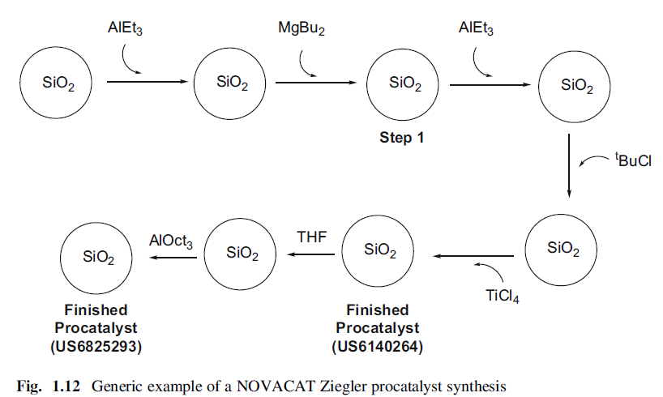
super-hexene” grade LLDPE
With respect to bimodal processes, the silica-based catalysts of Borealis for
Borstar and CX processes have excelled

Slide 25
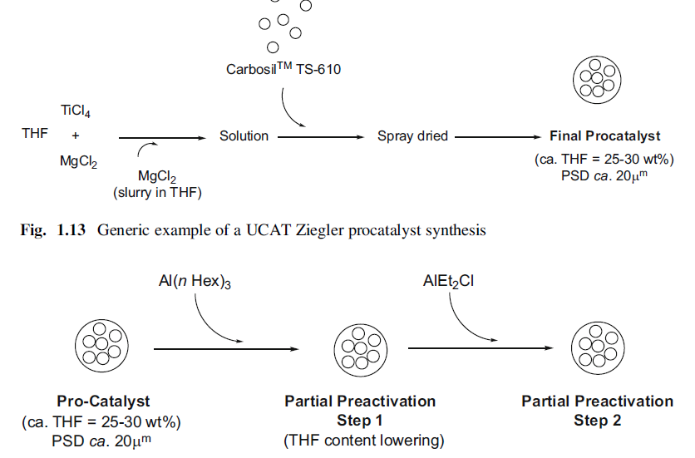
Spray-Dried MgCl2–Titanium Catalysts

Slide 26
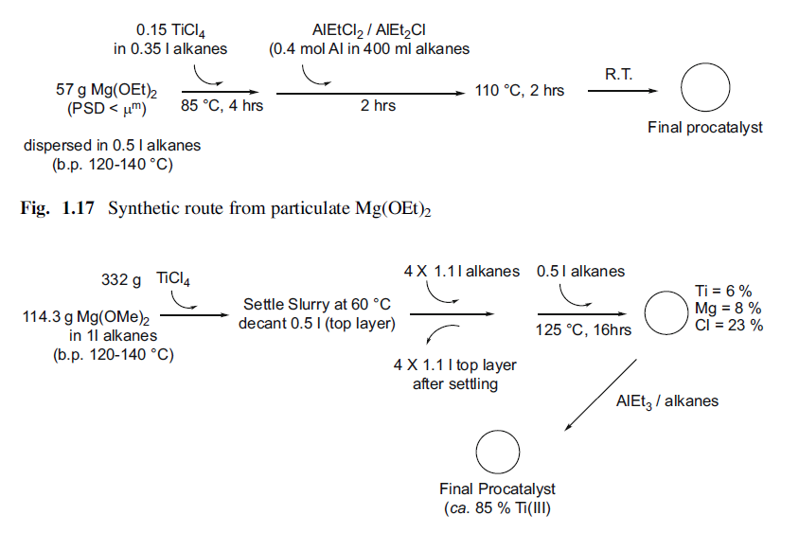
MgCl2–Titanium Catalysts Based on Mg(OR)2 HOCHEST Process

Slide 27
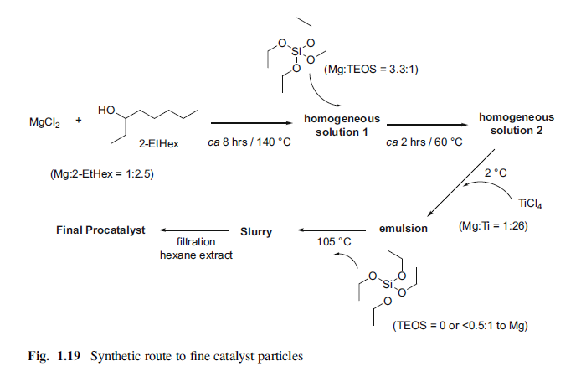
MgCl2–Titanium Catalysts Based on MgCl2 alcohol adducts MITSUIE Process

Slide 28
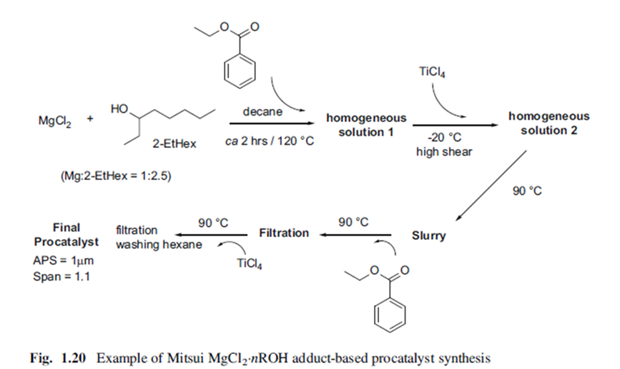

Slide 29
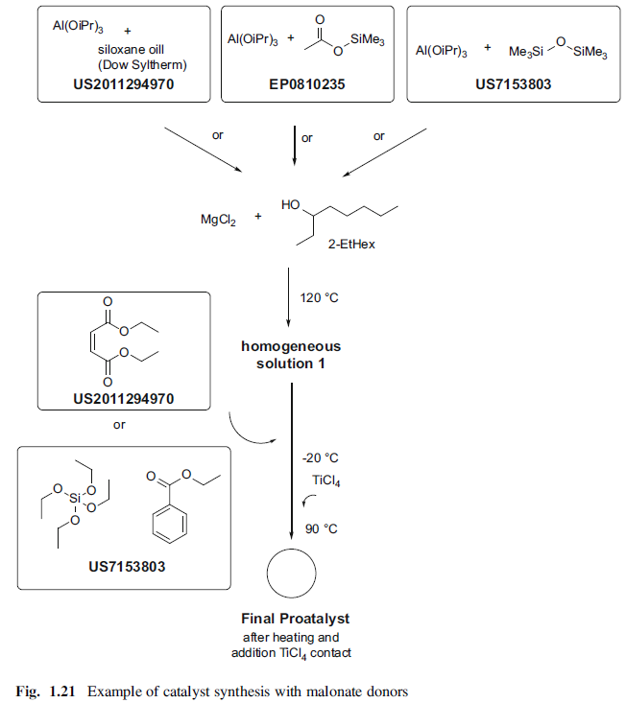

Slide 30
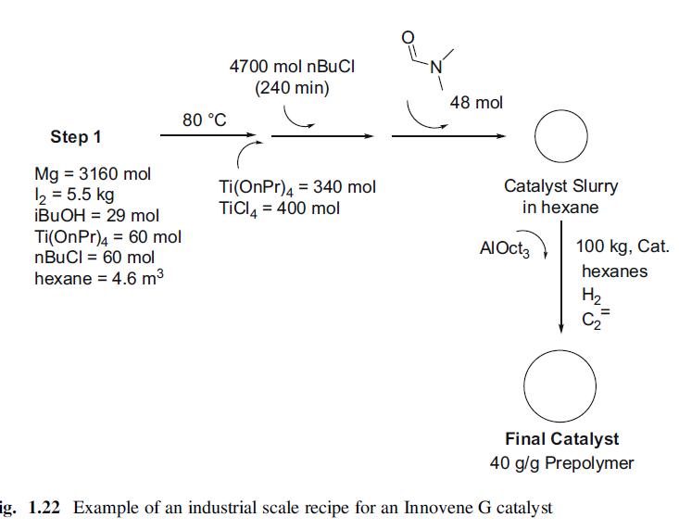

Slide 31
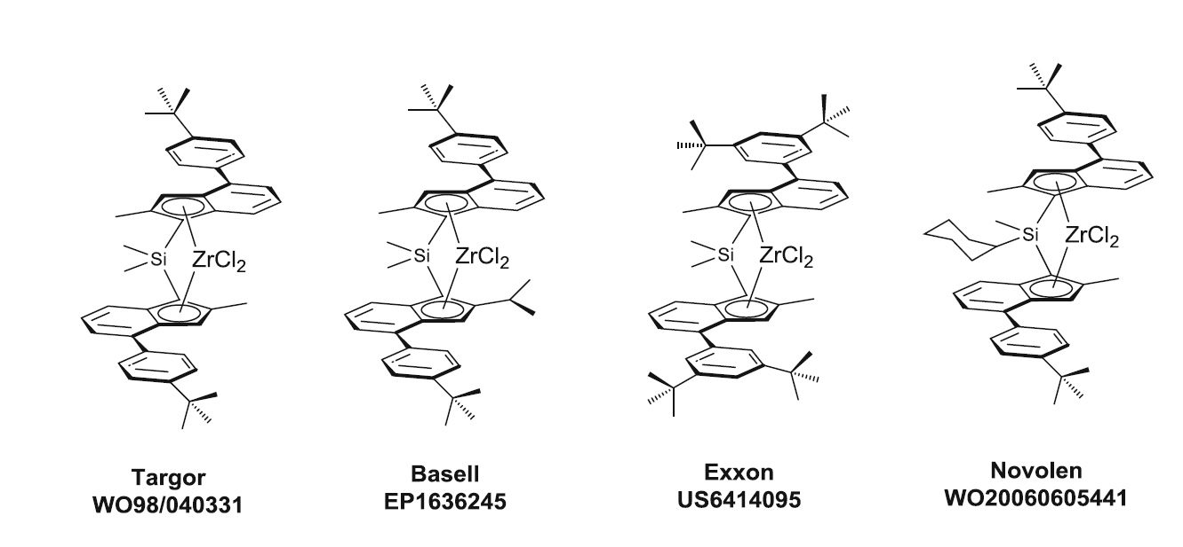
Polypropylene Complex Development
Complexes used for copolymerization of propylene with longerchain
olefins (1-butene, 1-hexene, 1-octene etc.)

Slide 32
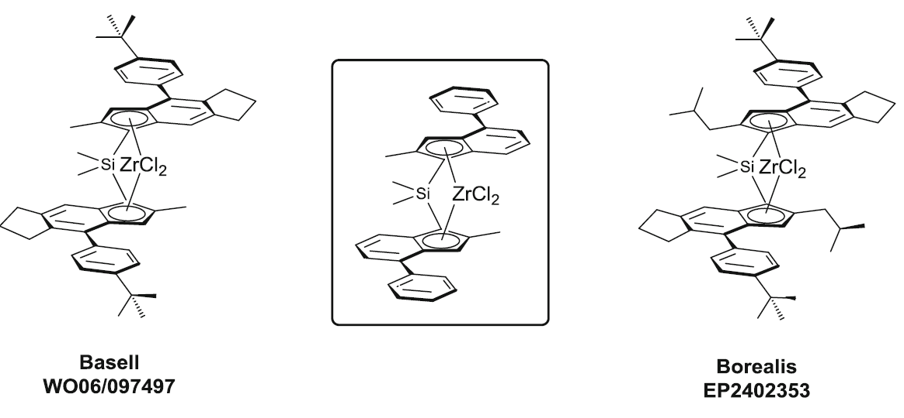

Slide 33
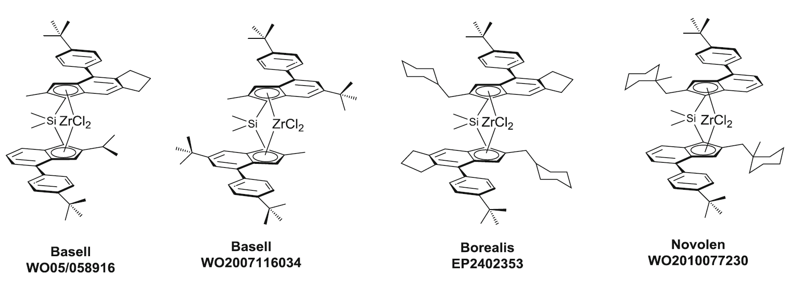

Slide 34
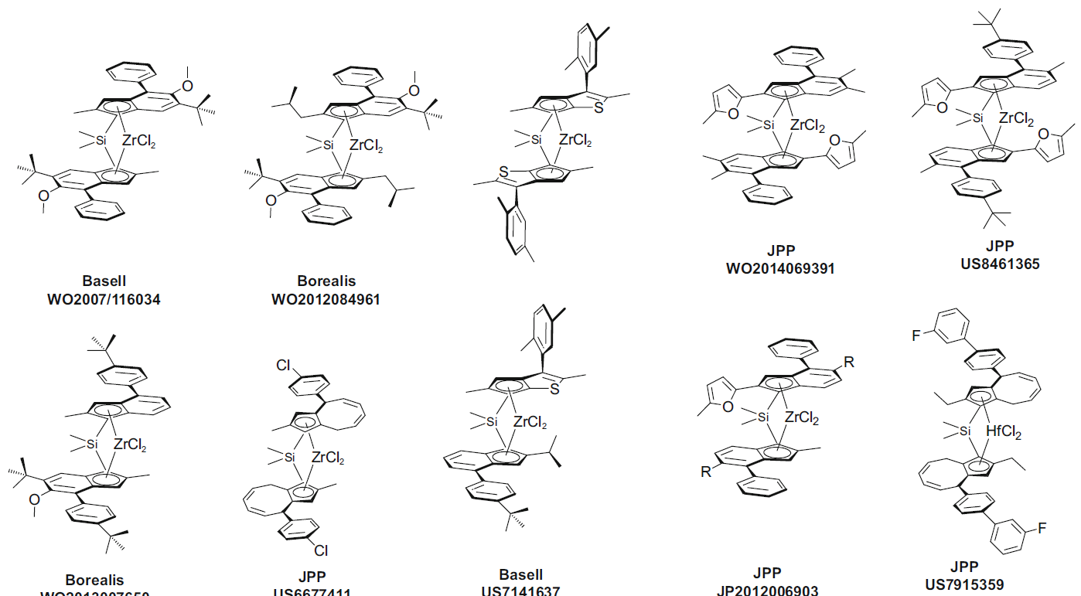

Slide 35
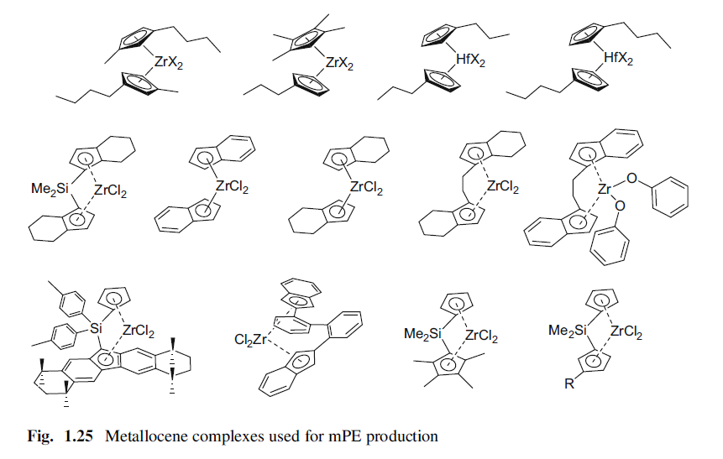
Polyethylene Complex Development

Slide 36
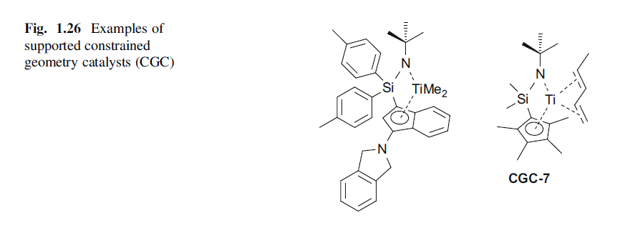

Slide 37
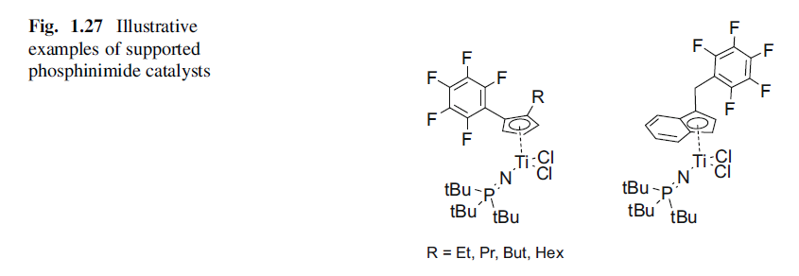

Slide 38
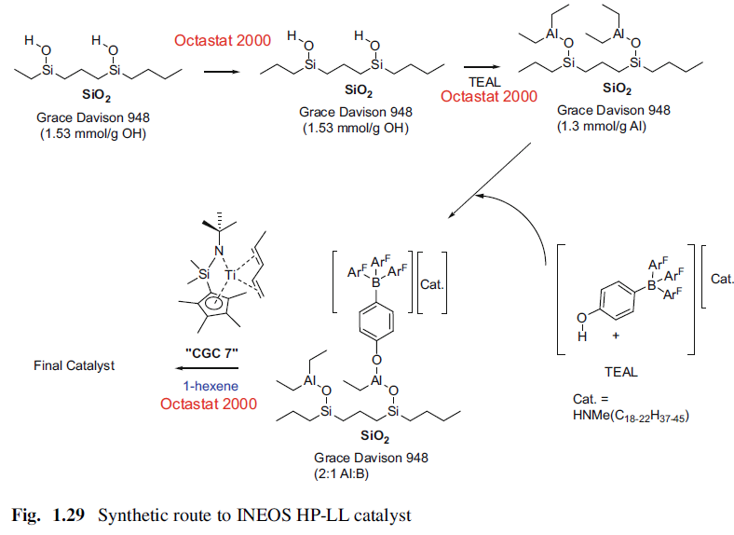
Supported Activator Development
Silica-Supported Methylaluminoxane or Boron-Based Cocatalysts

Slide 39
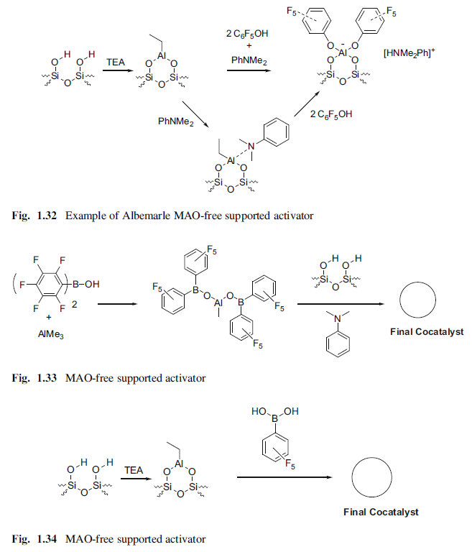
Supported Methylaluminoxane System Free of a Support

Slide 40
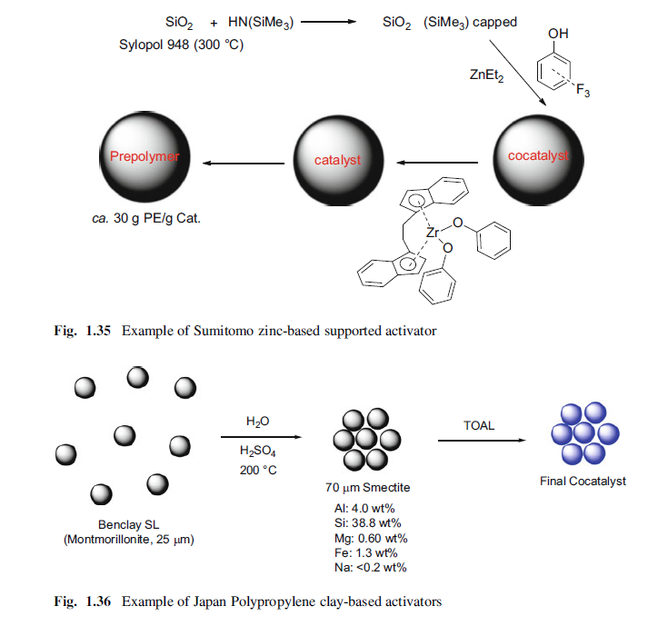
Supported Hybrid Catalyst for Multimodal Polyethylene

